Slide 1
Telescopes, the night sky and the Cosmos
Introduction to the LCOGT Telescopes

Slide 2
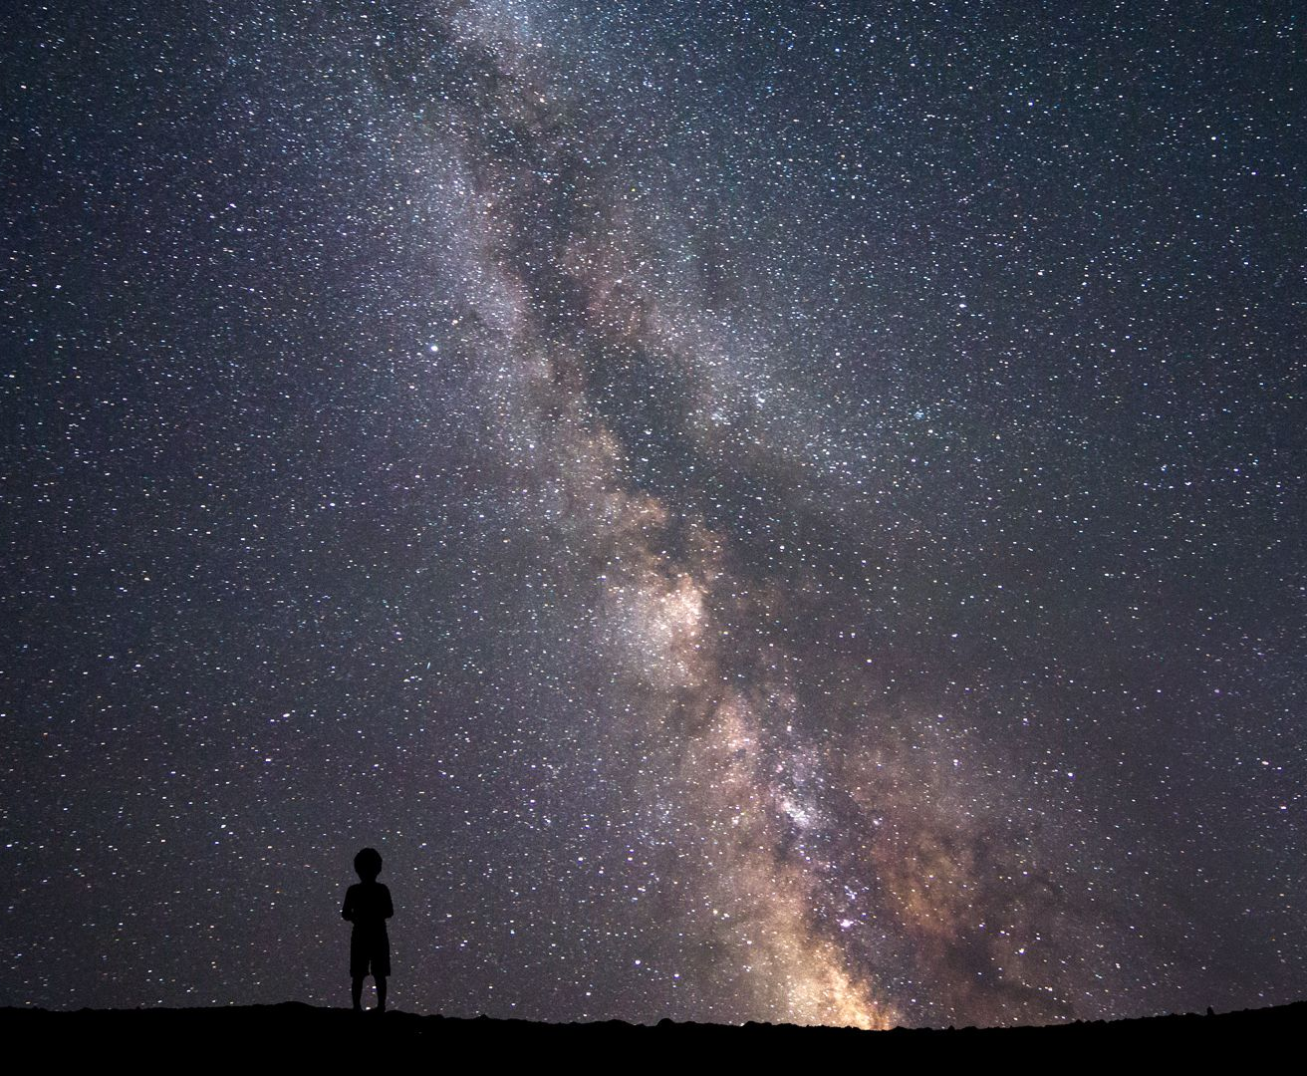
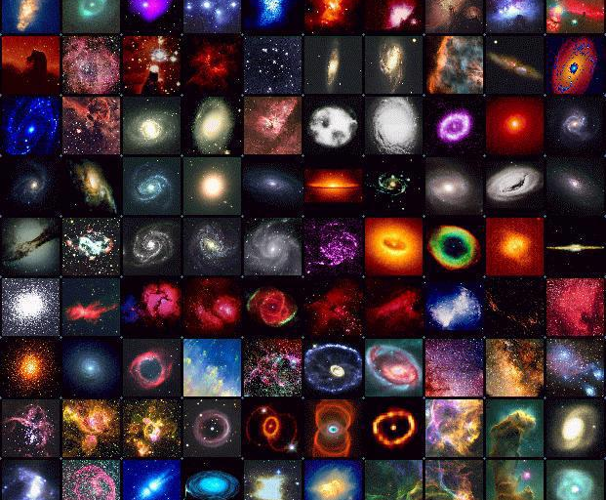
The night sky is full of spectacular objects

Slide 3
What are we seeing when we “see” a star?

Slide 5
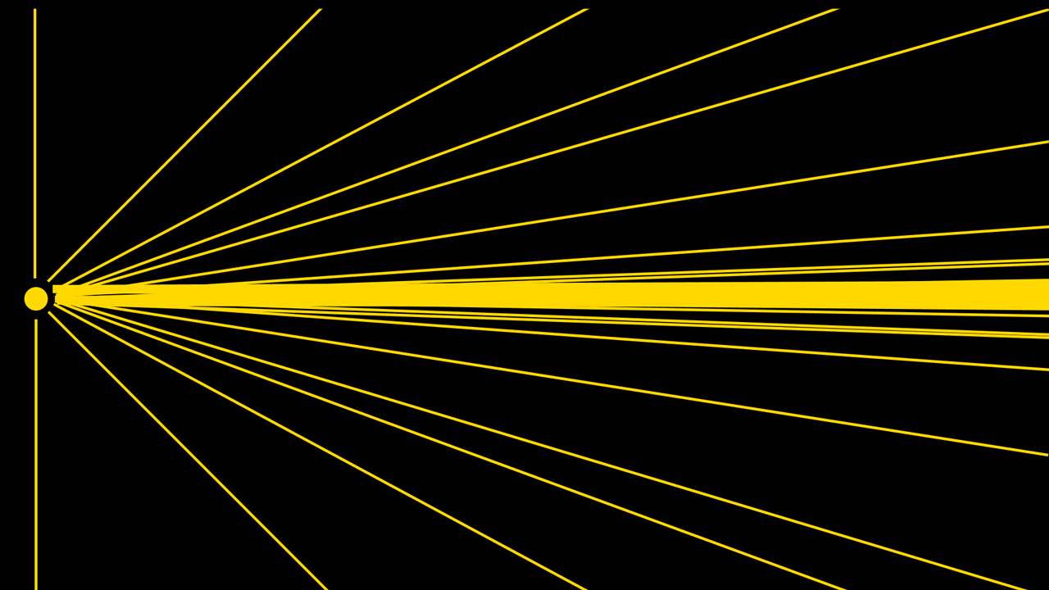

Slide 6
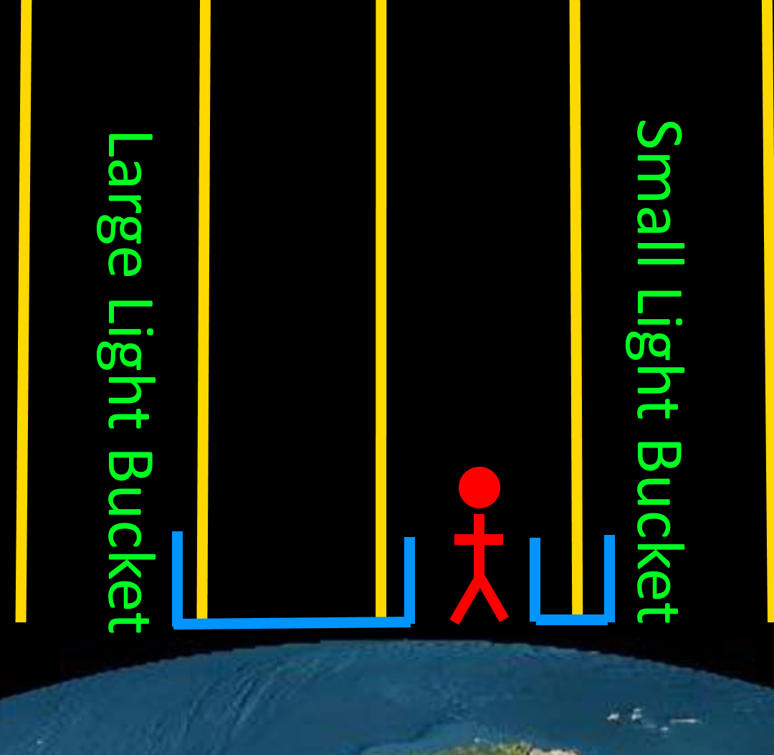
What are we seeing when we “see” a star?
We are essentially seeing starlight falling directly down on top of us.
The light rays are travelling essentially parallel at such great distances!
A telescope is like a light-bucket!

Slide 7
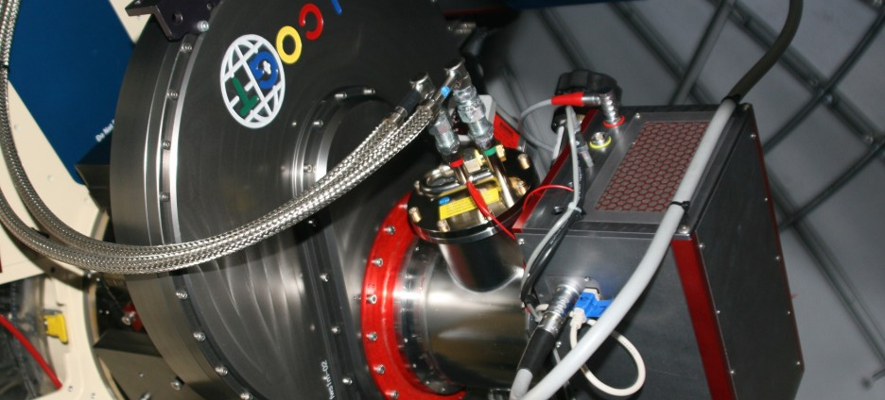
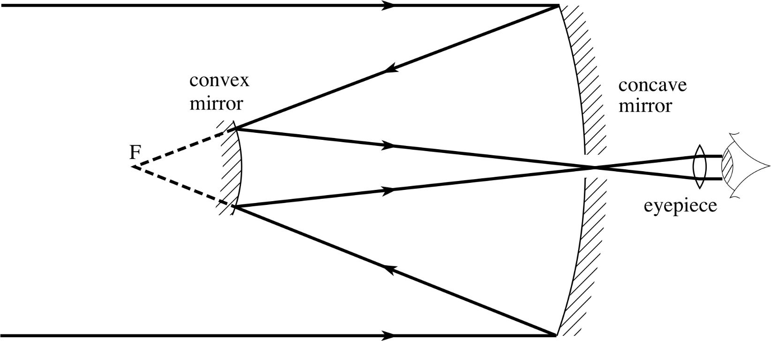
Light rays through a telescope
These rays travel into the telescope and get reflected through two curved mirrors to a detector at the end
The detector is rarely our own eyes but highly sensitive cameras!

Slide 8
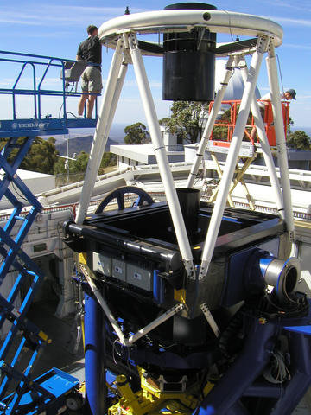
The Faulkes Telescopes in the LCOGT network are about 8 metres tall, but we call them “2 metre” telescopes
WHY?

Slide 9
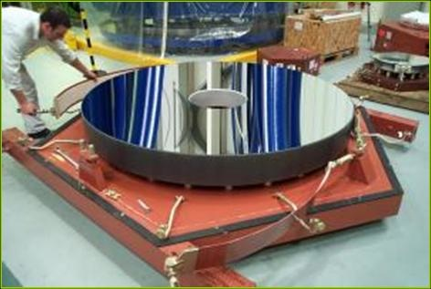
Because their MIRRORS are
2 metres in diameter

Slide 10
Why is mirror size the most important?
Click to view

Slide 11
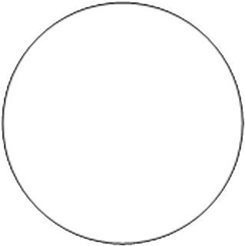

Different ‘mirror’ sizes.
Note: Binoculars and the Human Eye use lens rather than mirrors, but follow the same physical principles with regards to Sensitivity and Resolution.
LCOGT 1 metre
High-end ($5000+) Amateur Telescope (0.3 metres)
Anglo-Australian Telescope (3.9metres)
Hubble Space Telescope
(2.4 metres)
Faulkes Telescopes (2 metres)
Human Eye
(0.002 metres)

Slide 12
Sensitivity
So the bigger the bucket, the more light we get.
But HOW much more light?
How much extra light we can collect.
or
How much dimmer we can see.
/
=

Slide 13

Sensitivity
Anglo-Australian Telescope (Diameter = 3.9 metres)
Ratio of Areas of the Mirrors
Area of one mirror
Area of other mirror
= Ratio of sensitivity
LCOGT
(Diameter = 0.4 metres)

Slide 14
Sensitivity
Ratio of Areas of the Mirrors
Anglo-Australian Telescope (Diameter = 3.9 metres)
Area of one mirror
Area of other mirror
= Ratio of sensitivity
THEREFORE: The AAT is 95 times as sensitive as the LCOGT Telescope
Area of Circle
We can cancel the π’s, and use the Diameter instead of Radius
LCOGT Telescope
(Diameter = 0.4 metres)

Slide 15

Sensitivity
How much more sensitive are the LCOGT telescope compared to the human eye?
LCOGT Telescopes
(Diameter = 0.4 metres)
Human Eye
(0.002 metres)

Slide 16
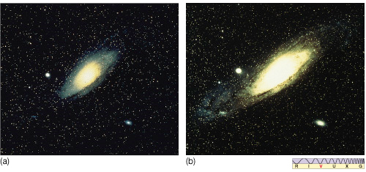
Sensitivity
Image (a) is taken with a telescope half the size of Image (b) with the same exposure time.

Slide 17
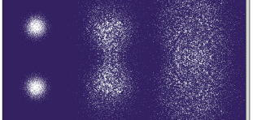
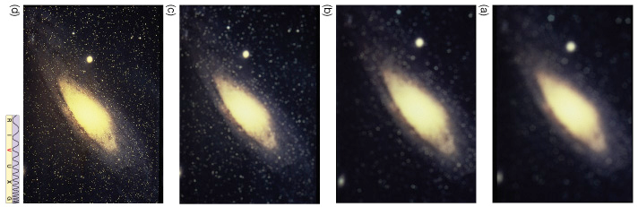
Resolution
The larger the mirror, the better the resolution.
Smaller telescopes.

Slide 18
Resolution
Ratio of Diameter of the Mirrors
Anglo-Australian Telescope (Diameter = 3.9 metres)
Diameter of one mirror
Diameter of other mirror
= Ratio of resolution
THEREFORE: The AAT has 9.75 the resolution of the LCOGT Telescope
LCOGT Telescopes
(Diameter = 0.4 metres)

Slide 19
Resolution
How much better resolution do we get with the LCOGT Telescope compared to the human eye?
LCOGT Telescopes
(Diameter = 0.4 metres)
Human Eye
(0.002 metres)

Slide 20
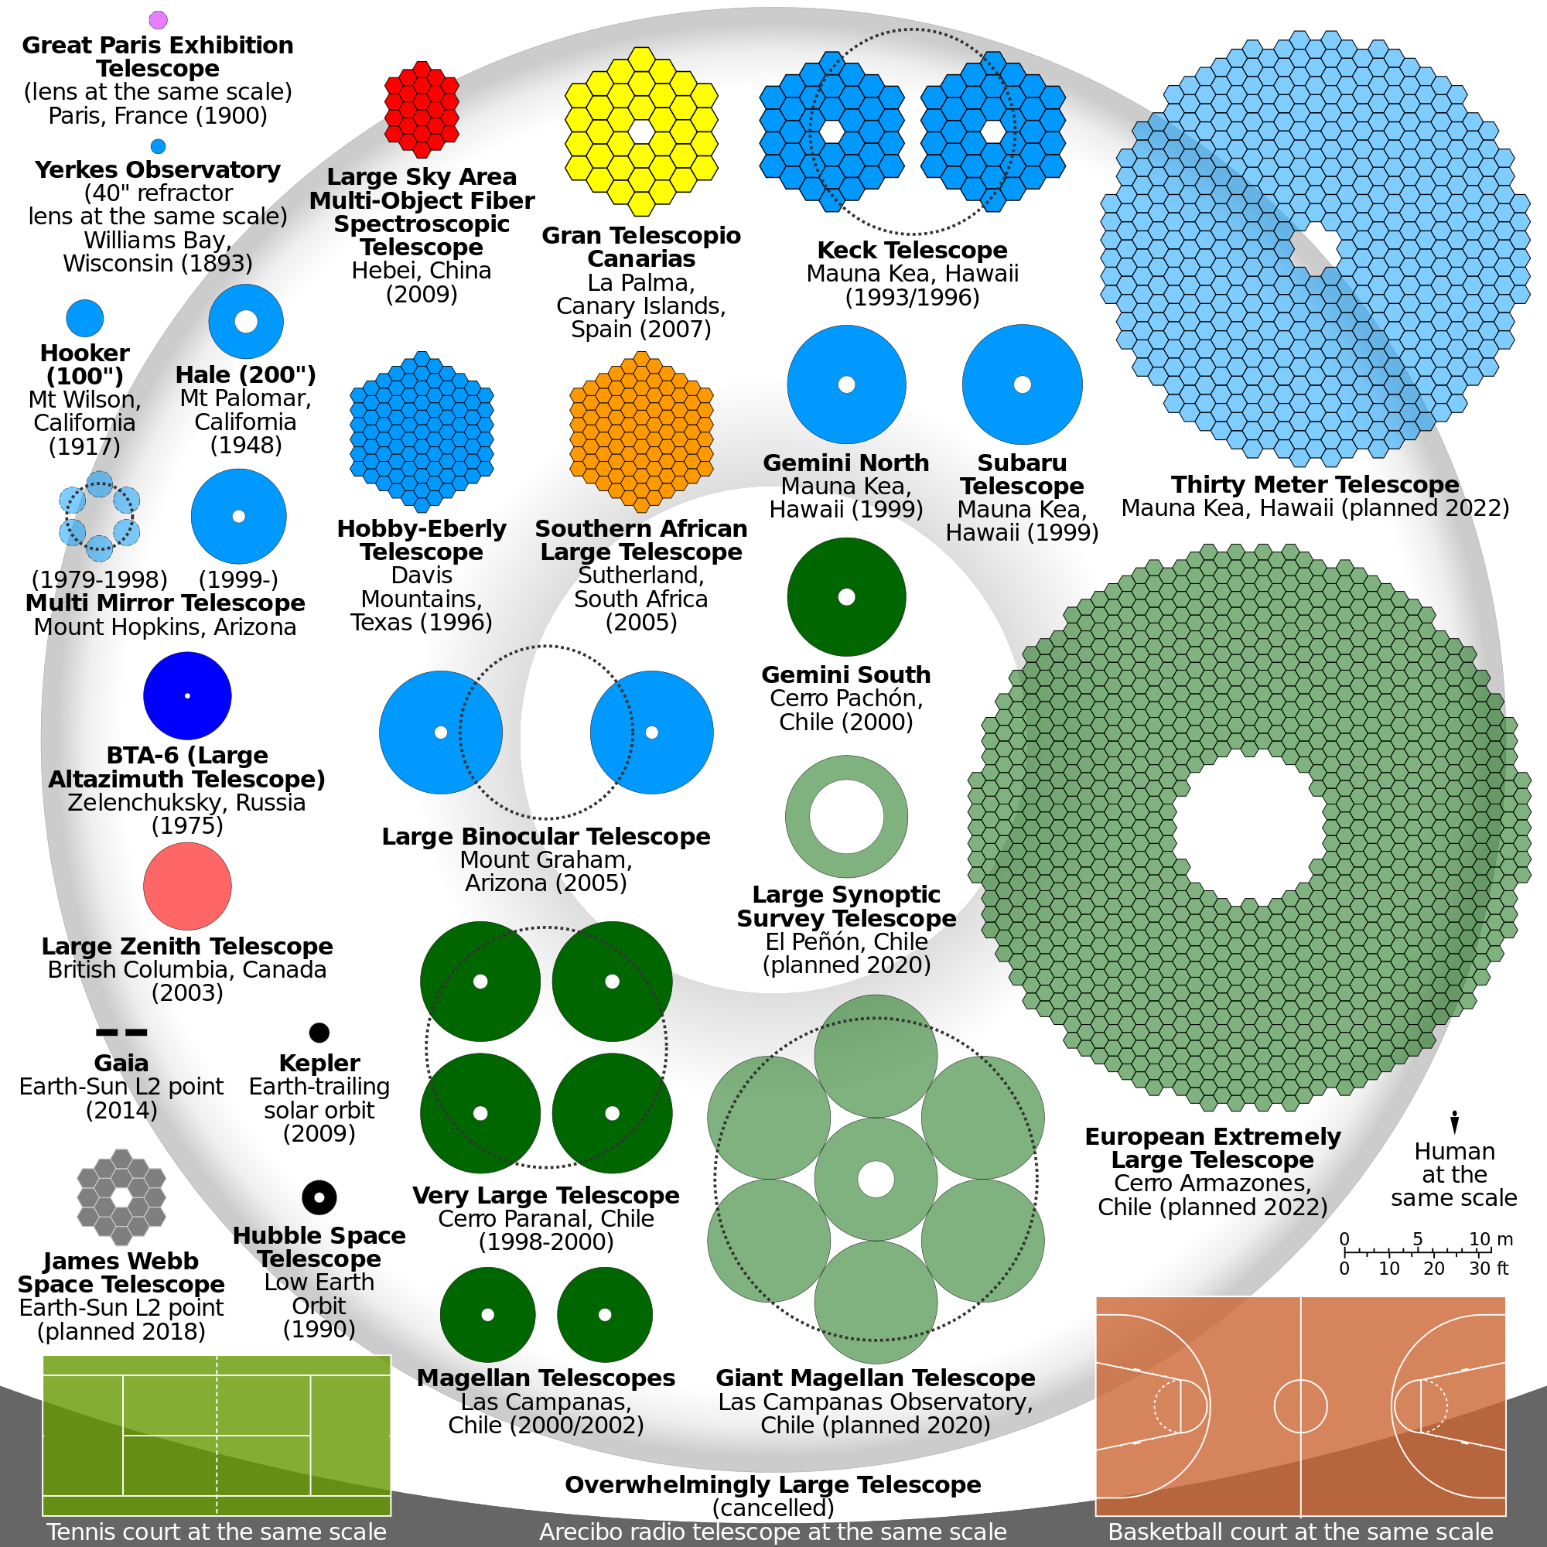
The Largest Telescopes
Here is a diagram showing the mirror sizes of the largest astronomical telescopes available and soon to be constructed.
For comparison, the 4 metre AAT in Siding Spring Observatory is roughly in the middle of the Hooker and the Hale telescopes.
One of the 0.4m telescopes would be just less than half the size of the Yerkes Observatory.

Slide 21
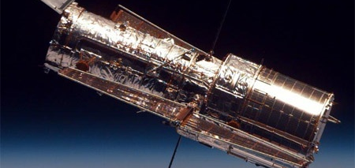
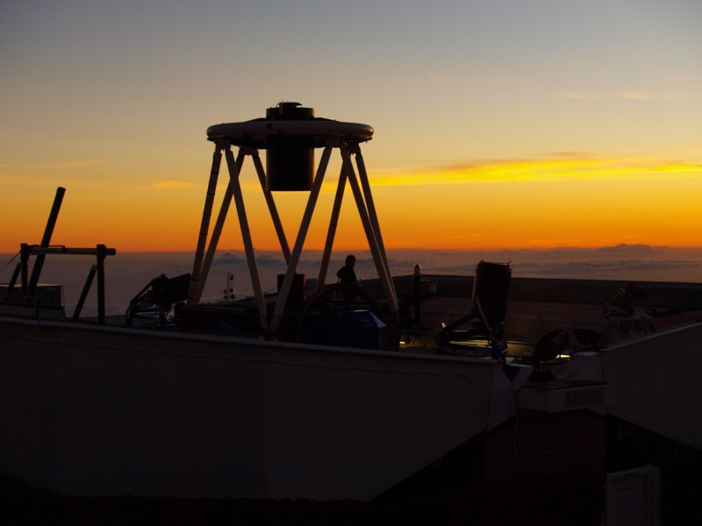
Ground versus Space
Hubble Space Telescope
(top image)
Space based ≈ 559 kilometres
Faulkes Telescope
(bottom image)
Ground based ≈ 3 kilometres

Slide 22
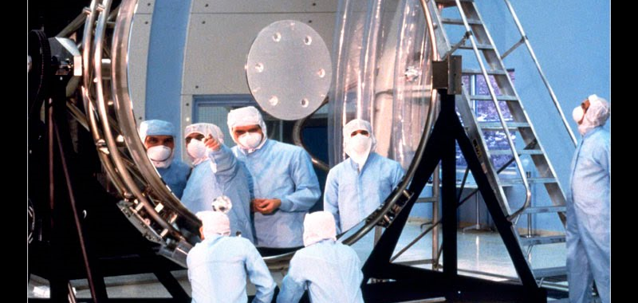
Ground versus Space
Hubble Space Telescope
(top image)
Mirror diameter = 2.4 metres
Faulkes Telescope
(bottom image)
Mirror diameter = 2 metres
Approximate Resolution of both mirrors is about 0.08 arcseconds

Slide 23
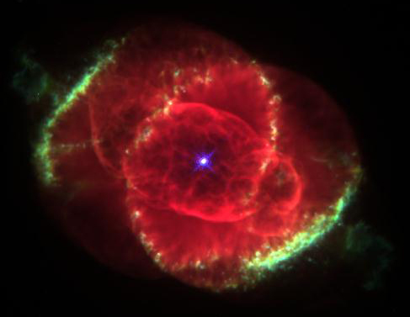
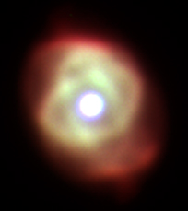
Ground versus Space
Why such wildly different image quality?

Slide 24
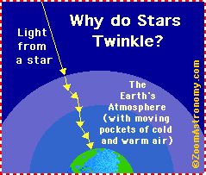
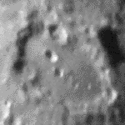
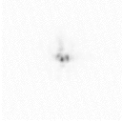
Ground versus Space
The atmosphere of the Earth ‘blurs’ the image and decreases the resolution.
The HST is beyond the atmosphere and hence does not experience ‘blurring’.

Slide 25
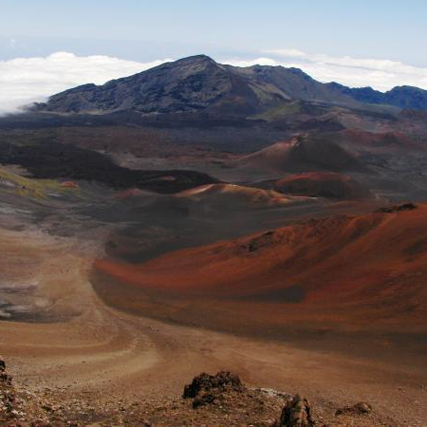
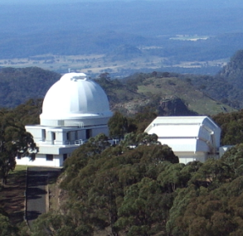
This is why telescopes are on mountains
Faulkes Telescope North:
Haleakala, Hawaii
≈ 10,000 Feet or 3000 metres
Faulkes Telescope South:
Siding Springs, NSW
≈ 3,800 Feet or 1150 metres

Slide 26
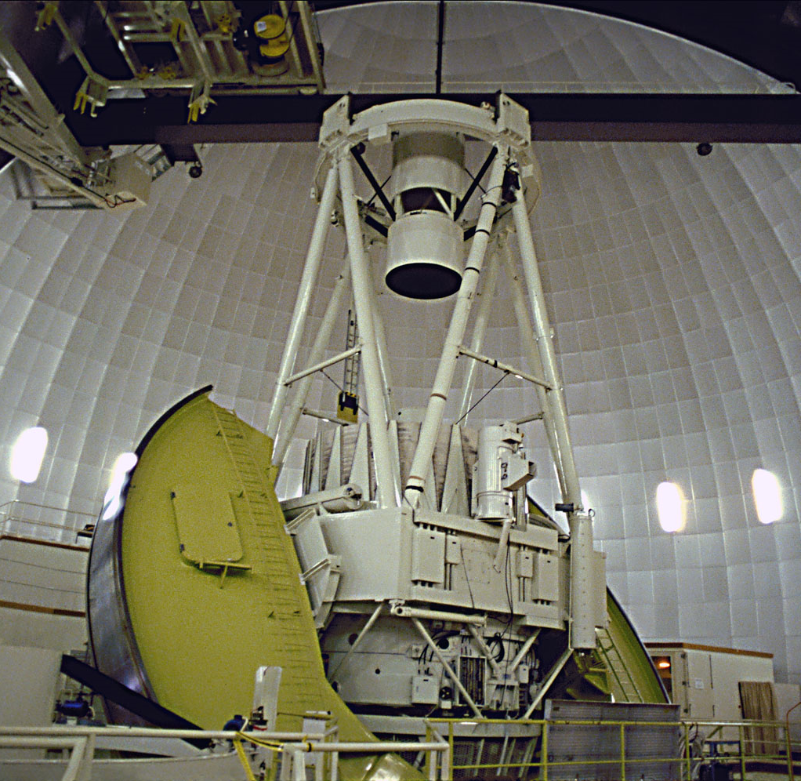
What else can we use a telescope for?
3.9m Anglo-Australian Telescope, Siding Springs, NSW

Slide 27
Magnification
There is no point in magnifying something that is too blurry. You will not see any extra detail. Hence, both resolution and telescope location are more important.

Slide 28
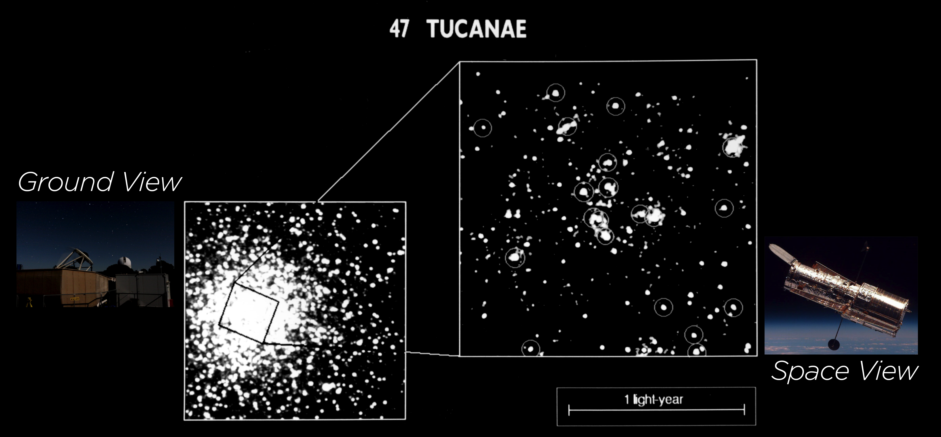
Magnification
There is no point in magnifying something that is too blurry. You will not see any extra detail. Hence, both resolution and telescope location are more important.

Slide 29
Summary
The size of a telescopes’ mirror is the most important aspect of a telescope, so much so that telescopes are named by their mirror size.
Telescopes are used primarily to see dim objects.
They are also used to look at objects with higher resolution or less blurriness.
The atmosphere affects our images quite dramatically, hence why we put telescopes on mountains or in space.
While telescopes can magnify an image, it is of the least importance.

Slide 30
www.oursolarsiblings.com

